Slide 1
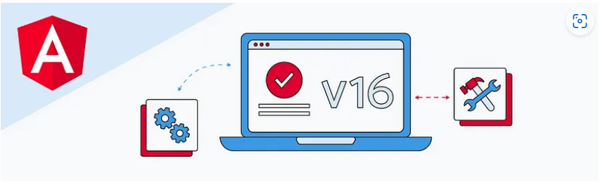
Feature highlights in Angular v16

Slide 2
Topic
Angular Signals
Standalone component
esbuild
Required inputs
Hydration

Slide 3
Angular Signals (Developer Preview)
It’s in “Developer Preview”
Syntax & features may change in future versions!
Patterns & best practices are still to evolve

Slide 4
Getting started with Signals
A different Way Of Detecting Changes
What & Why?
Creating & Using Signals
Updating Signal Values

Slide 5

Signals: What &Why

Slide 6
Signals vs “Classic Change Detection”
Classic Change Detection
(“Zone-based Change Detection”)
Changes are detected automatically
UI is updated automatically
Sounds perfect, right?
Performance could be better & bundle size is increased!
Signals
(Added as “Developer Preview” in V16)
No automatic change detection -- > You “tell” Angular when data changes
Angular updates only the parts of the UI where the data (“signal”) is used
Slightly more work
But full control, better performance & smaller bundle

Slide 7
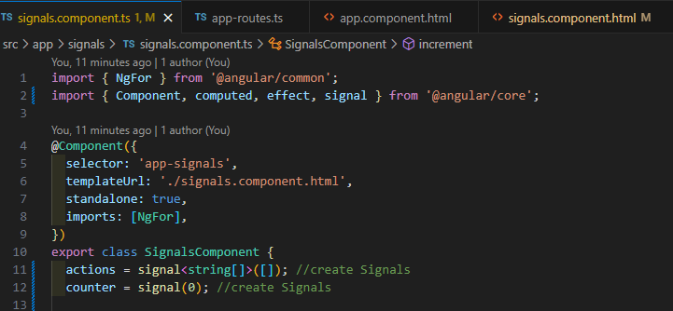
Create & Use Signals

Slide 8
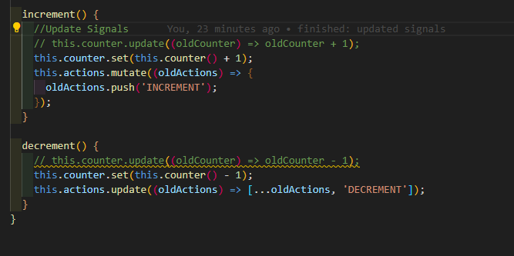
Update Value Signals

Slide 9
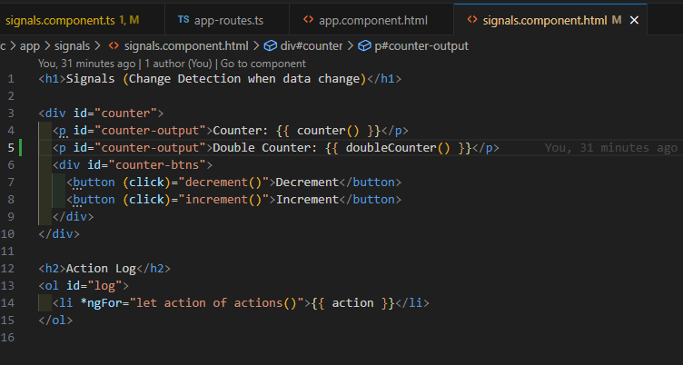
Reading & Outputting a Signals Value

Slide 10
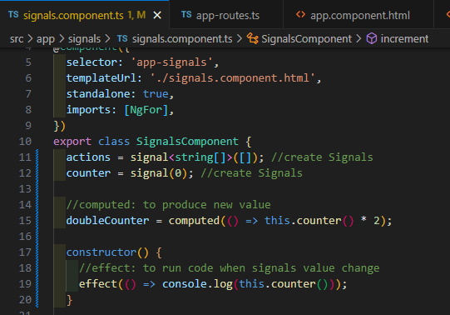
Computed & Effects

Slide 11
Signals: What's To Come?
The official RFCs: https://github.com/angular/angular/discussions/49685
If you're interested in exploring how using signals will look in Angular, then start with RFC #3: Signal-based components.

Slide 12
Standalone Component
Building components Without @NgModule
What & Why?
Basic Standalone Components
Adding Services, Routing & Lazy Loading
Migrate an existing Angular project to standalone

Slide 13
Pros and Cons of Standalone Components
Advantages:
1. Reusability and Modularity:
Standalone components encapsulate specific functionalities, promoting reusability. This modularity allows developers to integrate components seamlessly across various parts of the application or even across distinct projects.
2. Easy Maintenance:
Isolating functionality within standalone components simplifies maintenance and updates. Changes or bug fixes in one component do not affect others, reducing the risk of unintended consequences.
3. Clear Separation of Concerns:
Standalone components adhere to the Single Responsibility Principle (SRP), focusing on specific tasks or features. This promotes a clear separation of concerns, making code more organized and easier to understand.

Slide 14
Pros and Cons of Standalone Components
Disadvantages:
1. Potential Overhead:
In smaller applications, the use of standalone components might introduce unnecessary complexity. The overhead of creating and managing numerous components can outweigh the benefits.
2. Communication Overhead:
While standalone components promote isolation, they may require additional effort to communicate with other parts of the application. This can lead to increased complexity in managing state and passing data between components.

Slide 15
esbuilt
V16 builder base on esbuild. In addition integration with Vite powering the Cli’s development server.
Setup by updating in angular.json
"architect": {
"build": {
"builder": "@angular-devkit/build-angular:browser-esbuild",

Slide 16
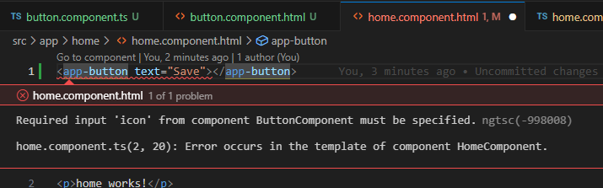
Require @Inputs
You can now mark component and directive inputs as required:
export class ButtonComponent {
@Input({ required: true }) text = 'submit';
@Input({ required: true }) icon = 'string';
}
If a template includes a component without specifying all of its required inputs, Angular reports an error at build time.

Slide 17
What is hydration
Hydration is the process that restores the server side rendered application on the client.
This includes things like reusing the server rendered DOM structures, persisting the application state, transferring application data that was retrieved already by the server, and other processes.

Slide 18
Why is hydration important?
Hydration improves application performance by avoiding extra work to re-create DOM nodes. Instead, Angular tries to match existing DOM elements to the applications structure at runtime and reuses DOM nodes when possible.
This results in a performance improvement that can be measured using Core Web Vitals (CWV) statistics, such as reducing the First-contentful paint FCP and Largest Contentful Paint (LCP), as well as Cumulative Layout Shift (CLS). Improving these numbers also affects things like SEO performance.
Without hydration enabled, server side rendered Angular applications will destroy and re-render the application's DOM, which may result in a visible UI flicker. This re-rendering can negatively impact Core Web Vitals like LCP and cause a layout shift. Enabling hydration allows the existing DOM to be re-used and prevents a flicker.

Slide 19
How do you enable hydration in Angular
Before you can get started with hydration, you must have a server side rendered (SSR) application. Follow the Angular SSR Guide to enable server side rendering first.
Once you have SSR working with your application, you can enable hydration by visiting your main app component or module and importing provideClientHydration from @angular/platform-browser. You'll then add that provider to your app's bootstrapping providers list.
Angular Universal v16: ng add @nguniversal/express-engine
import {provideClientHydration} from '@angular/platform-browser';
import {NgModule} from '@angular/core';
@NgModule({
…
providers: [provideClientHydration()],
})
export class AppModule {}

